Slide 1
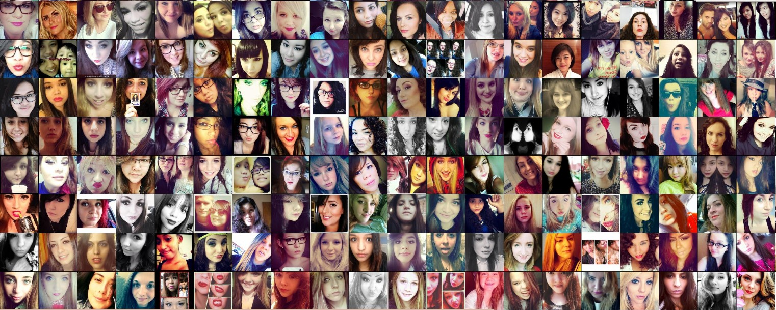
DEEP LEARNING ON PORTRAITS
GINA CHUNG

Slide 2

Introduction
Combining my interest in data science and photography
classifying the quality of portraits

Slide 3
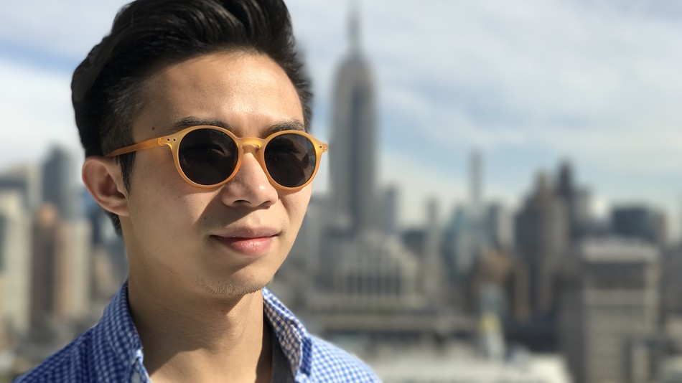
Applications
As of march 2019 >384 million images #selfie
Use an app to to get unbiased instant feedback
Know what features to look for in future photos
Notes:
many photos have been taken but
what

Slide 4
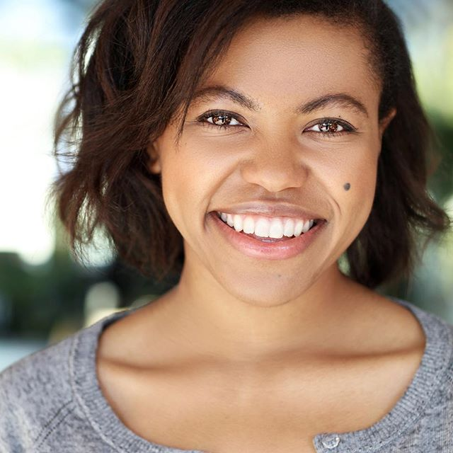
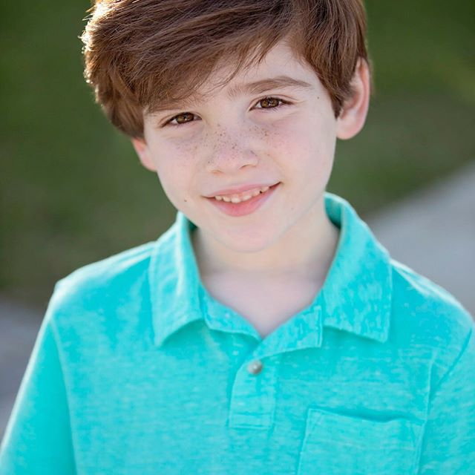
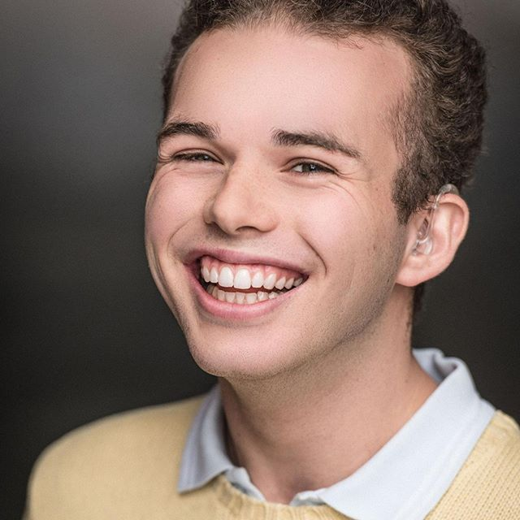


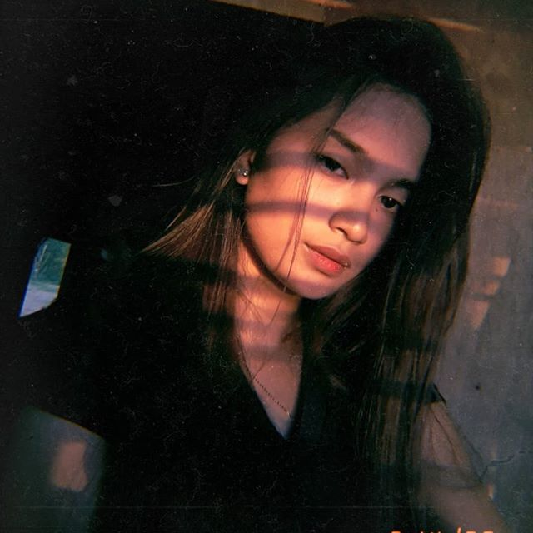
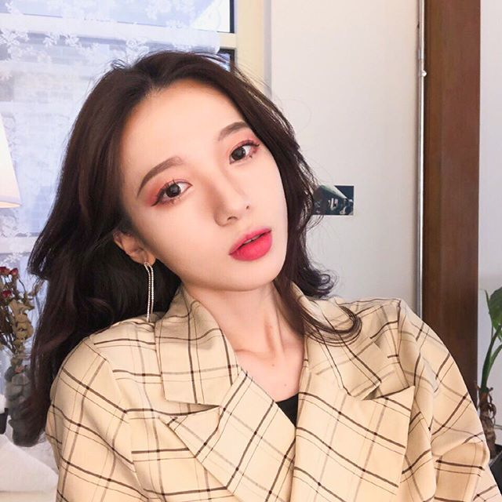
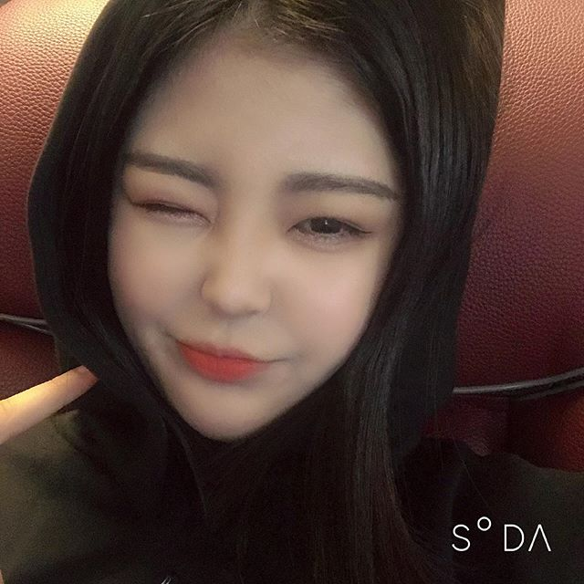
Data
20 000+ images with #headshot as the good dataset
20 000+ images with #selfie as the bad dataset
I Applied an open cv face detection extractor to to Identify the images with faces and removed images incorrectly categorized
GOOD
BAD

Slide 5
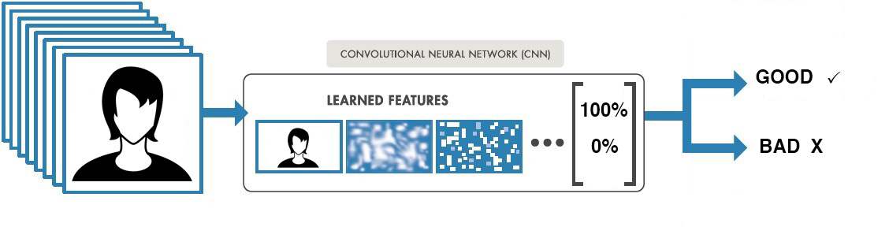
CONVOLUTIONAL NEURAL NETWORK
Fed images to a pretrained cnn with trained layers and a classifier to come up with a prediction
MODEL ACCURACY 84%

Slide 6
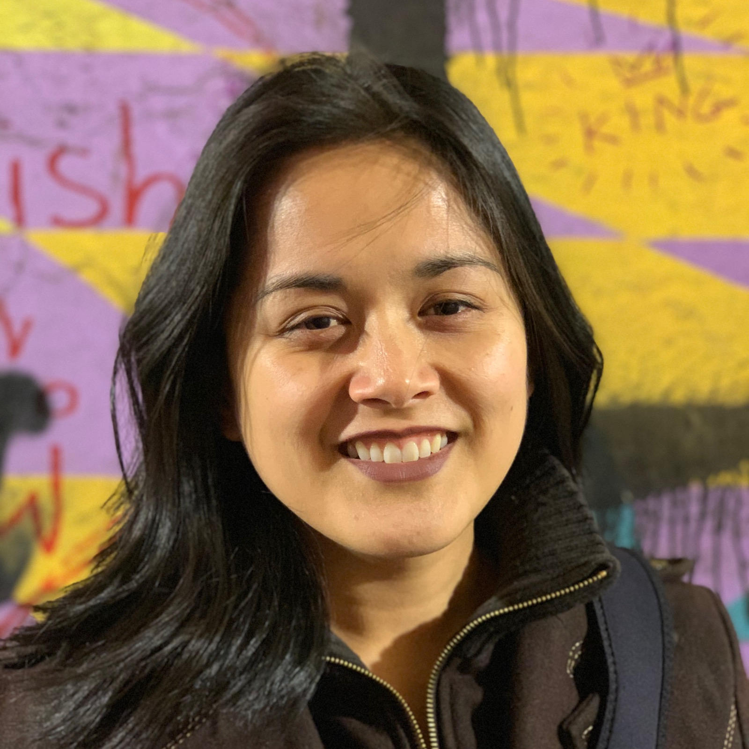
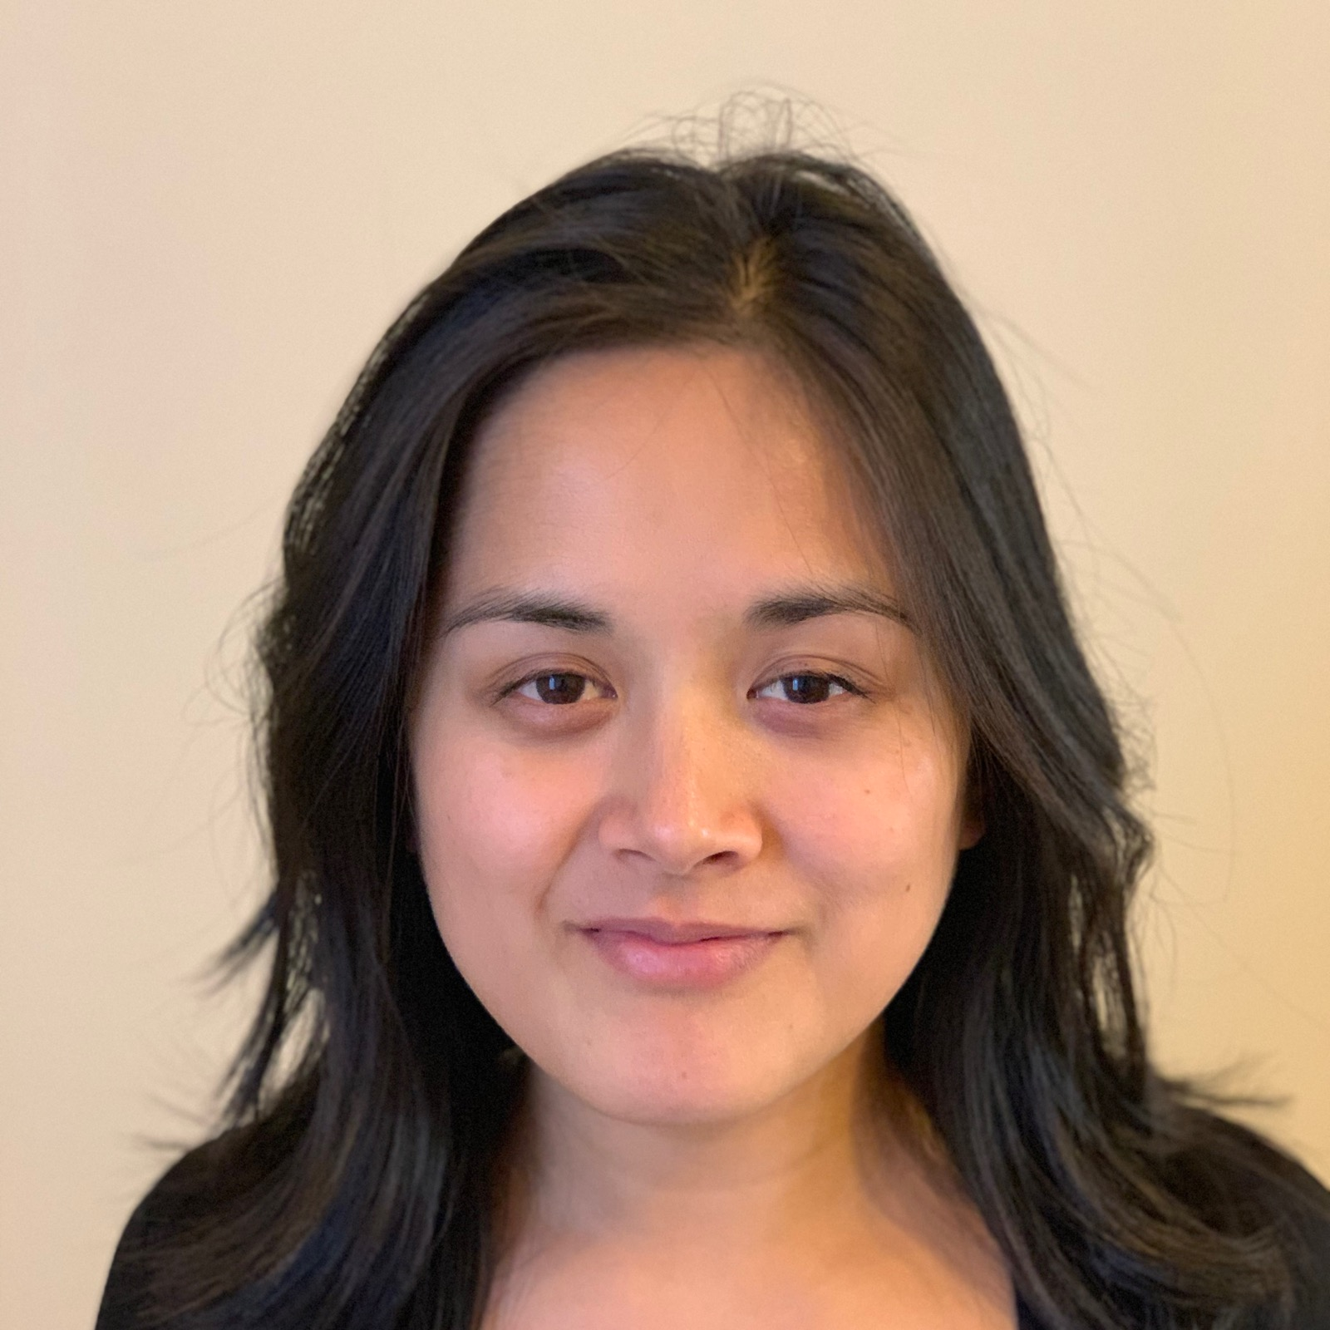
WHAT MAKES A GOOD IMAGE?
MODEL RESULT: BAD
MODEL RESULT: GOOD

Slide 7

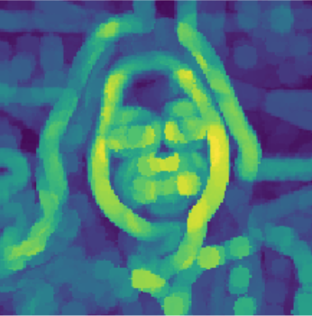
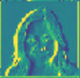
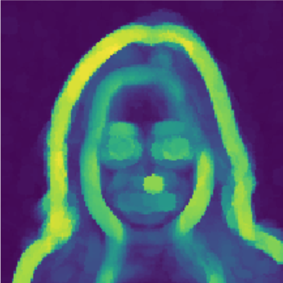
MODEL RESULT: BAD
MODEL RESULT: GOOD
CNN DENSE LAYER
SKIMAGE
CNN DENSE LAYER
SKIMAGE
Used skimage Gradient detection showing the difference in contrast of the image

Slide 8
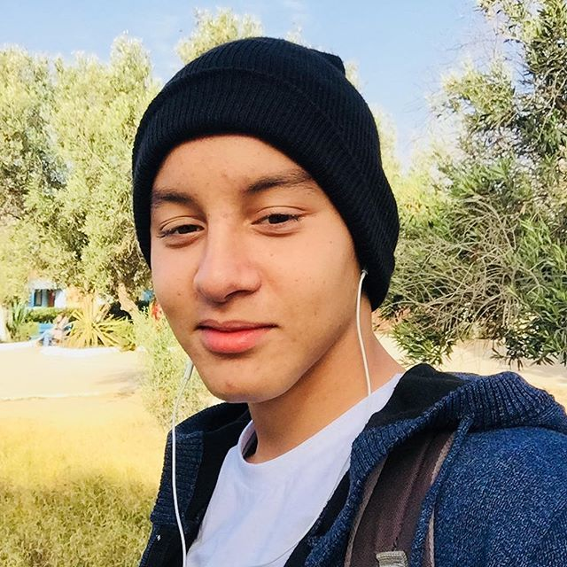
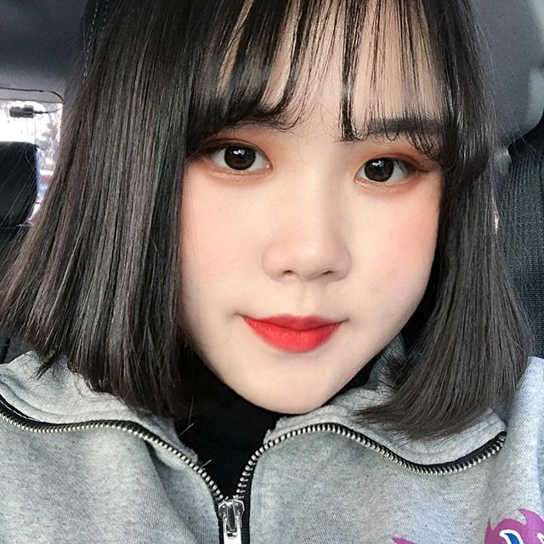

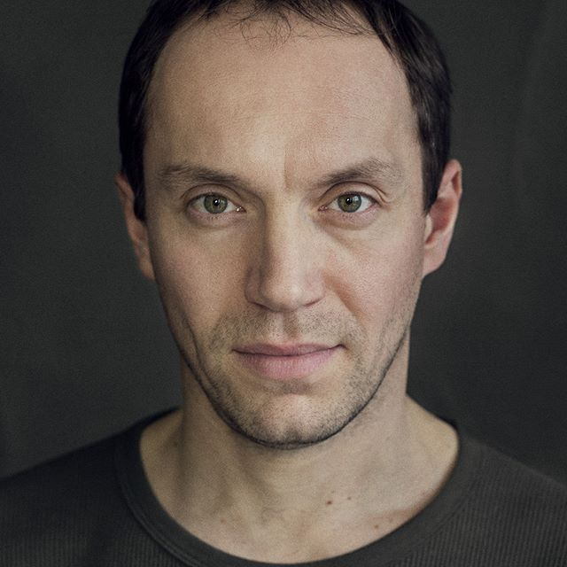

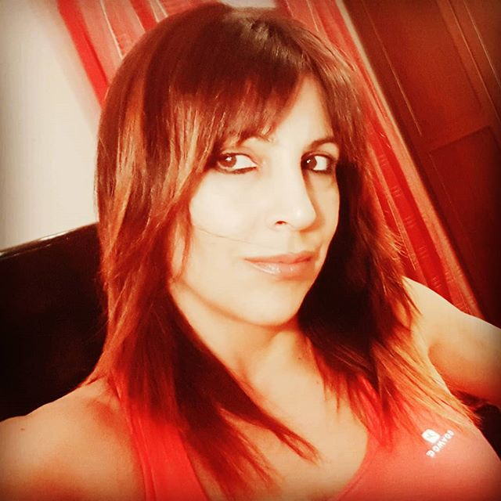

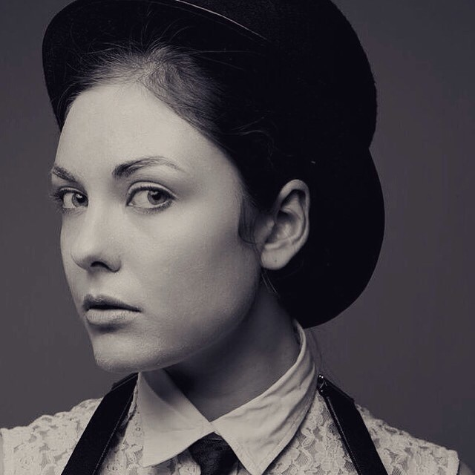
RESULTS
MODEL RESULT: BAD
MODEL RESULT: GOOD

Slide 9
DEMO

Slide 10
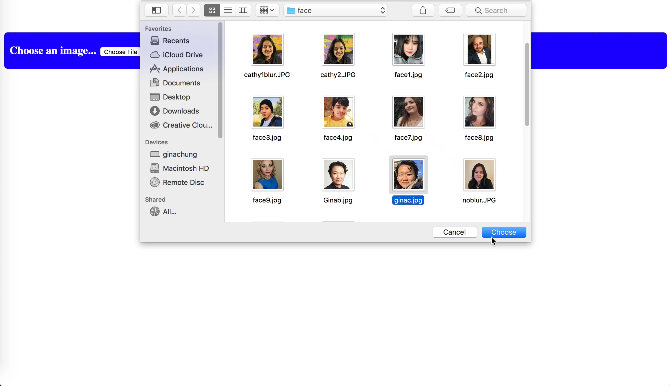

Slide 11
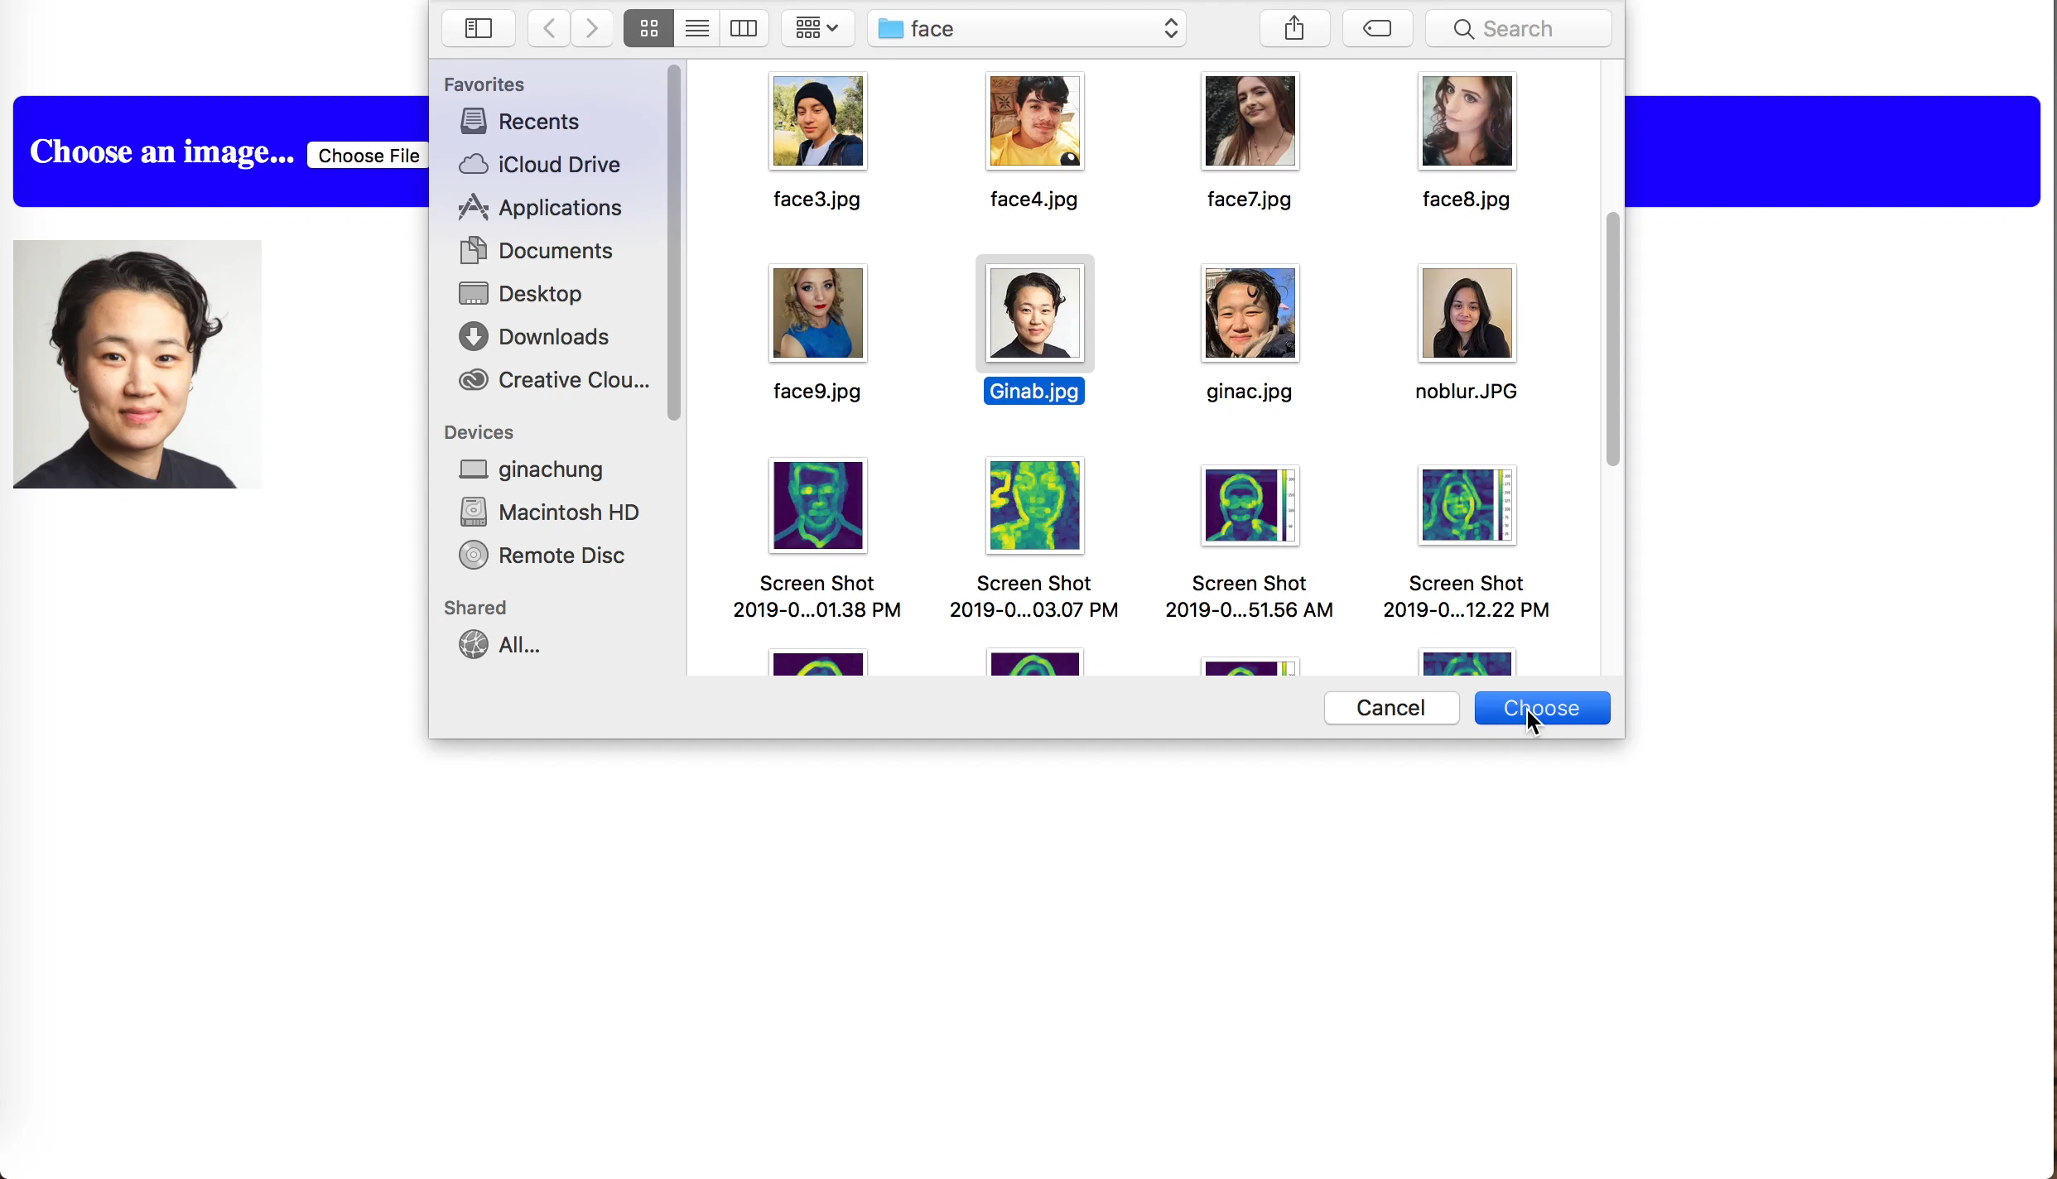

Slide 12
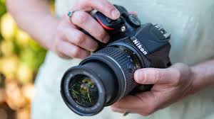
summary
the goal was to create a model that will give instantaneous feedback on portraits and be able to share that through an app
build upon this proof of concept and ultimately build an improved version of the app that can also identify other areas for improvement

Slide 13
THANK YOU
GINA CHUNG
www.linkedin.com/gchung478
gchung3@gmail.com

Slide 15
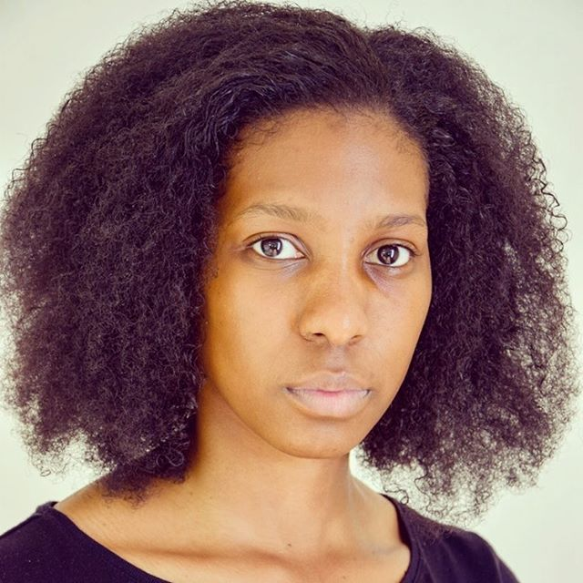
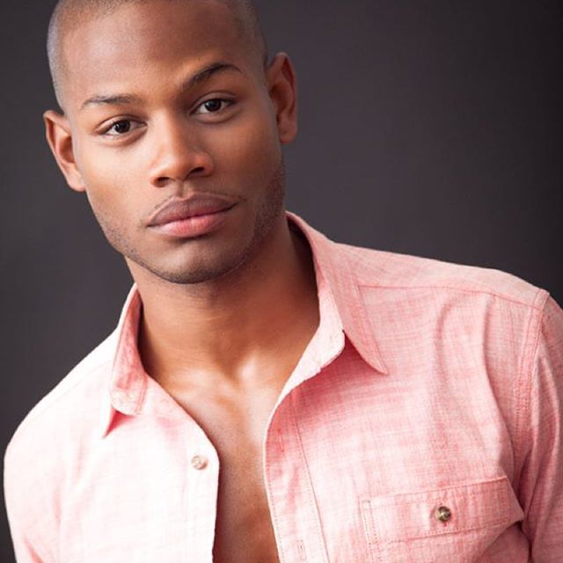
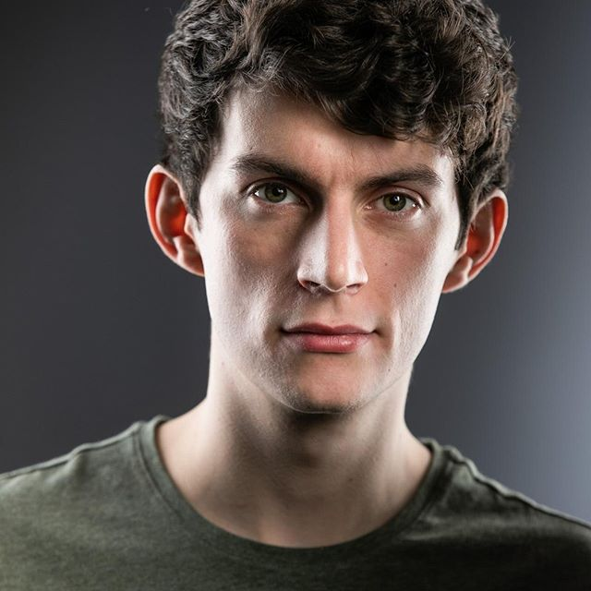

MORE RESULTS
MODEL RESULT: GOOD

Slide 16


Slide 17


Slide 18
What to look for
Focus on the eyes and face
Clear background
Separation between the background and face
Balanced lighting

